Slide 1

Florida Forecast for Kidney Allocation: 2020-2025
Juliette Barbera
December 2019

Slide 2
Outline of Presentation
Overview of Organ Procurement and Allocation Policy Process
Changes to Kidney and Pancreas Organ Allocation
Impact on the State of Florida and the University of Florida
Recommendations

Slide 3
Organ Procurement and Allocation Policy Process
The National Organ Transplant Policy Act (NOTA) established the Organ Procurement and Transplantation Network (OPTN) in 1984
The U.S. Department of Health and Human Services (HHS) implemented a Final Rule in 2000 establishing a regulatory framework for the OPTN
The Public-Private Partnership has a board of Directors and Committees that informs decision making

Slide 4
NOTA and The Final Rule
NOTA – Establishing Regulation
The Final Rule – Protocol

Slide 5
Final Rule: In Progress…
The Need to Enact the Final Rule has Prompted Policy Changes to Organ Allocation

Slide 6

OPTN Vision Statement
“The OPTN promotes long, healthy and productive lives for persons with organ failure by promoting maximized organ supply, effective and safe care, and equitable organ allocation and access to transplantation; and doing so by balancing competing goals in ways that are transparent, inclusive, and enhance public trust in the national organ donation system.”

Slide 7
The OPTN Initiatives
The three-year period priorities were approved by the OPTN Board of Directors in June 2018:
Increase the number of transplants
Provide equity in access to transplants
Promote efficiency in donation and transplant
Promote living donor and transplant recipient safety
Improve waitlisted patient, living donor and transplant recipient outcomes

Slide 8
Kidney Committee
“The Kidney Transplantation Committee is charged with considering medical, scientific, and ethical aspects related to kidney organ procurement, distribution, and allocation. The Committee considers both the broad implications and the specific member situations relating to kidney issues and policies. The goal of the committee's work is to develop evidence-based policies aimed at reducing the burden of renal disease in transplant patients (candidates and recipients), increasing kidney utilization, improving access to kidney transplantation as appropriate, and improving the health outcomes of kidney transplant recipients, fostering access to transplantation and good outcomes for patients (including waiting candidates and living donors) involved in kidney transplantation.”

Slide 9


Slide 10
OPTN Strategic Goal For Kidney Allocation: Provide Equity in Access to Transplants
Jan. 2020
June 2018
Dec. 2019: 250 NM
Sept. 2018
Oct. 2019
Aug. 2019: 500 NM

Slide 11
Allocation Policy: Replace DSA and Regions Model with 250 NM Model
Now – Allocation is Constrained by the Location of Donor and Recipient
2020 – Allocation is Expanded Geographically

Slide 12
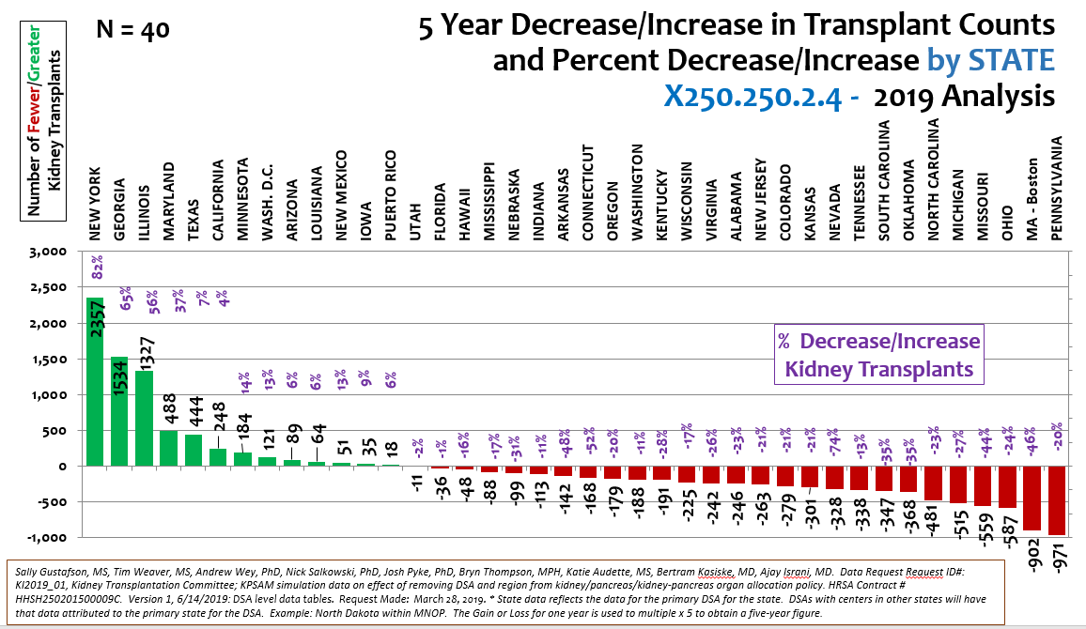
Impact on the State of Florida

Slide 13
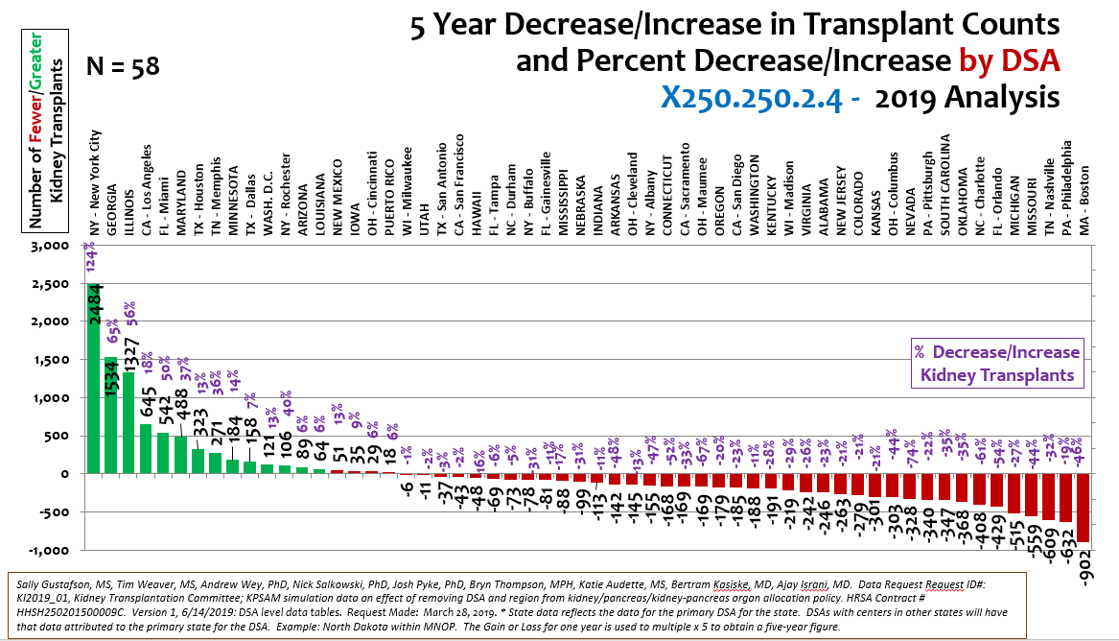
Impact on the University of Florida

Slide 14
OPTN Policy Framework: Limited Location = Barrier to Allocation
Policy Problems Define Policy Solutions:
Proposed Problem – Limited Location
Proposed Solution – Geographic Expansion
Alternative Perspective - Focus on Acquiring More Organs:
Increase Donors
Use Rejected Organs

Slide 15
Recommendation Based on Data Projection:
Equity Issue Based on Location Continues
OPTN Process:
Three-year Strategy on Organ Allocation: 2018-2021
Post Implementation Review
Policy has Opportunity for Reconsideration: Possible Failure Rate Due to Transporting Organs Nationwide and Lawsuits
Recommendation to Stakeholders:
Bicameral and Bipartisan Solutions – Florida Politicians
Lobbying - Florida Delegation and Additional States

Slide 16
Sources
https://uscode.house.gov/view.xhtml?hl=false&edition=prelim&req=granuleid%3AUSC-2014-title42-section274&num=0
https://optn.transplant.hrsa.gov/governance/public-comment/eliminate-the-use-of-dsa-and-region-in-kidney-allocation-policy/
https://unos.org/policy/kidney-pancreas/policy-updates/
https://optn.transplant.hrsa.gov/members/committees/kidney-committee/
https://optn.transplant.hrsa.gov/media/3390/optn-policies-effective-as-of-dec-4-2019-board-adoptions.pdf
https://optn.transplant.hrsa.gov/governance/public-comment/eliminate-the-use-of-dsa-and-region-in-kidney-allocation-policy/
https://optn.transplant.hrsa.gov/media/2768/kp_analysisreport_20181207.pdf
Carpenter D, Husain SA, Brennan C, Batal I, Hall IE, Santoriello D, Rosen R, Crew RJ, Campenot E, Dube GK, Radhakrishnan J, Stokes MB, Sandoval PR, D Agati V, Cohen DJ, Ratner LE, Markowitz G, Mohan S. Procurement Biopsies in the Evaluation of Deceased Donor Kidneys. Clin J Am Soc Nephrol. 2018 Dec 7;13(12):1876-1885. doi: 10.2215/CJN.04150418. Epub 2018 Oct 25

